Slide 1
WhatsApp Group Chat Analysis & Sentiment Analysis
Akash Gupta
Department of Statistics
University of Delhi
Contact: 8377849418
email: akash.gupta.stats@gmail.com

Slide 2

Just For Fun

Slide 3
Acknowledgement: Its true that everyday we generate huge amounts of text online but analysing this text data isn’t an easy task. Converting text into structured information to analyse with a machine will be a complex task. In recent year Text mining has become a lot more accessible for data analysts, developers and data scientists. This study is basically based on the text data from WhatsApp Group chat. In this study we will see the some statistics for the text data by summarising them and also see by graphically. And we will able to determine over all sentiment of the WhatsApp group. Here sentiment analysis or emotion AI (Opinion mining) refers to the use of Natural Language Processing and Text Mining to systematically identify, extract, quantify and study affective states and subjective information. Data Source: “The Second Years WhatsApp Group”

Slide 4
Process
To convert text into different documents
Consists of 6 columns date, time, sender, message & length
Text mining
Import text data from WhatsApp Group
Build Corpus
Clean Text
Convert it in
Data Frame
Plots
Analysis

Slide 5
Data Interpretation

Slide 6
Text Data & Data Frame
Unstructured Data:
[1] "02/10/2017, 4:39 pm - Messages to this group are now secured with end-to-end encryption. Tap for more info."
[2] "02/10/2017, 4:02 pm - Mradu created group \"Only 1st years-M.sc\""
[3] "02/10/2017, 4:39 pm - Mradu added you"
[4] "02/10/2017, 4:39 pm - Mradu added +91 99712 64557"
[5] "02/10/2017, 4:39 pm - You're now an admin"
[6] "02/10/2017, 4:39 pm - +91 80051 70927 added +91 87459 36097"
Note: 02/10/2017, Chat was started for this group with the name “Only 1st years-M.sc” in my mobile phone.
Structured Data:
 | date | time | sender | message | message_length
191 | 03-10-2017 | 10.20 | Biraj Das | Anybody asked sir? | 18
192 | 03-10-2017 | 10.24 | Nikita | I asked him | 11
193 | 03-10-2017 | 10.24 | Nikita | He read the message but didn't reply | 36
194 | 03-10-2017 | 10.25 | Biraj Das | then what to do | 15
195 | 03-10-2017 | 10.25 | Biraj Das | Read all! | 9
196 | 03-10-2017 | 10.34 | Sukhmani Marwah | Unhe request kar lo ki Syllabus naa badhayein yaar.. | 52
197 | 03-10-2017 | 10.37 | Tamanna Yadav | sir ko 5 min ke liye is grp me add Karlo | 40

Slide 7
Exploring The Data:
Summary of the data frame:
date | time | sender | message | message_length
02/11/2018: 327 | 08:27 : 163 | Sukhmani Marwah: 753 | Length:10676 | Min. : 0.00
06/10/2017: 267 | 09:59 : 63 | Vrinda Sharma : 613 | Class :character | 1st Qu.: 4.00
16/01/2019: 233 | 12:07 :55 | Biraj Das : 566 | Mode :character | Median : 18.00
02/10/2017: 188 | 11:24 :53 | Rohit Chauhan : 440 |  | Mean : 25.11
19/11/2017: 165 | 8:33 :50 | Megha Arora : 427 |  | 3rd Qu.: 30.00
03/02/2018: 148 | 9:52 :50 | (Other) :7877 |  | Max. :745.00
(Other) :9348 | (Other):10242
An average people chat with message length approximately 25 words (including whitespaces).
We can see here no of chat corresponding to the date;
02/11/2018 : A huge discussion about the date changes for the 3 semester examination.
16/01/2019 : hahahaha this one is important date, Bloody Saturday, chat between unsatisfied people of Group A
and C for their issue.
06/10/2017 : three things were on this date, 1st Birthday of Tammana and 2nd unhealthy Biraj Das and 3rd was
discussion about strategy making for 1st Semester Examination.

Slide 8
Top 25 More Responding Sender in decreasing Order: (Top Left – Bottom Right)
Sukhmani Marwah | Vrinda Sharma | Biraj Das | Rohit Chauhan | Megha Arora
753 | 613 | 566 | 440 | 427
Arkobrato Gupta | Kriti Sareen | Mradu | Tamanna Yadav | Geetika
344 | 321 | 321 | 271 | 260
Nina | Kunzang | Zeba Khan | Srestha Dutta | Madhurima Saha
257 | 248 | 200 | 194 | 192
Sumit Yadav | Rajat Aggarwal | Praveen Gautam | Soumya | Puskar Gautam
176 | 166 | 163 | 161 | 155
Pratigya Barnwal | Pallavi Yadav | Rashi Jain | Ujan | Kiran Singh
154 | 149 | 148 | 146 | 136
Top 25 Less Responding Sender in increasing Order:
(Top Left – Bottom Right)
+91 70424 12490 | +91 83840 29019 | +91 99712 64557 | Akansha | Pooja Gosingha
1 | 1 | 2 | 2 | 2
+91 70119 31715 | +91 87458 04762 | Dinesh | Mandeep | Gourav
3 | 4 | 4 | 5 | 7
Narendra Yadav | Sourabh Kumar | Bharti Sihag | +91 70153 03629 | Amrit Kaur
8 | 8 | 9 | 10 | 10
Subham Goswami | Kalpna | Divya Jain | +91 99902 49889 | Gargi
10 | 12 | 14 | 15 | 15
Reshmi Neogy | +91 95415 87506 | Subhajit Nandi | Jagrti Garg | Ankita Sharma
19 | 20 | 20 | 21 | 23

Slide 9
Visualization

Slide 10
Bar Plot: Graph that presents categorical data with rectangular bars with heights or lengths proportional to the values that they represent. Word Cloud: An Image composed of words used in a particular text or subject, in which the size of each word indicates its frequency or importance.

Slide 11
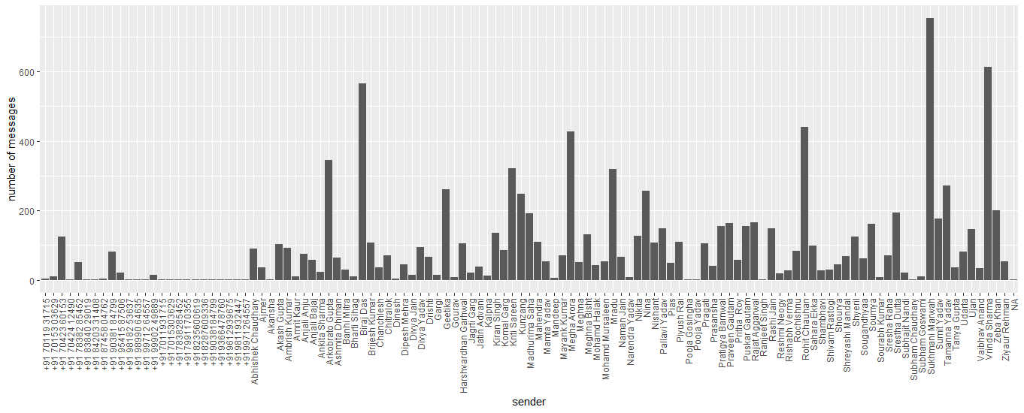
Sender V/s Number of Message:

Slide 12
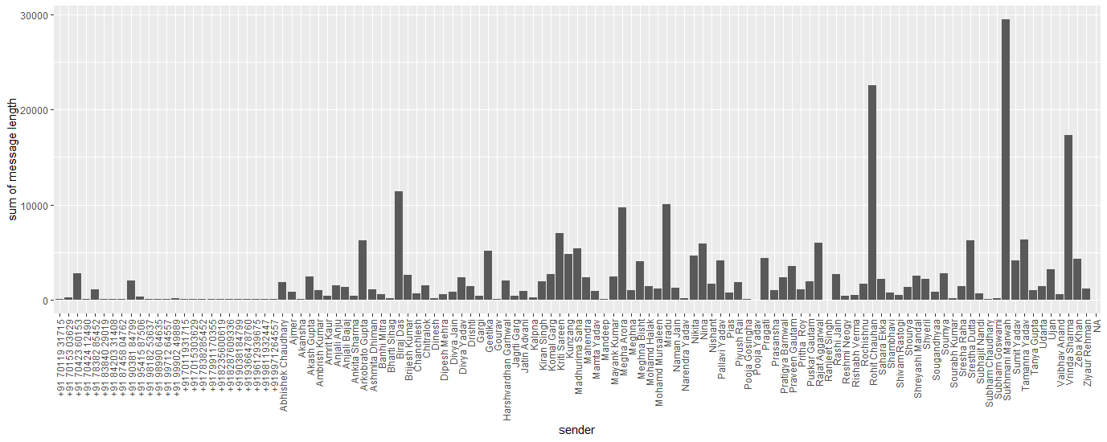
Sender V/s Sum of Message Length:

Slide 13
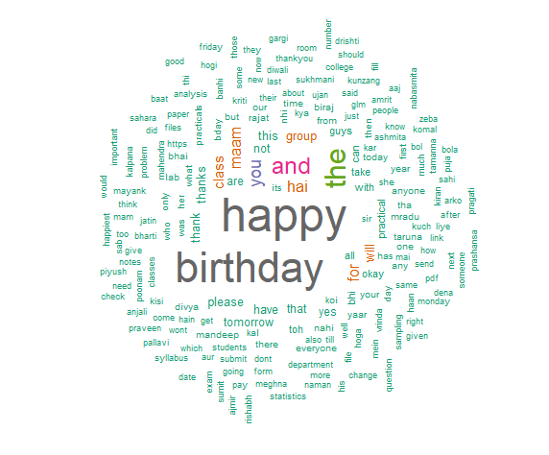
Word Cloud of Message:
Frequency table for top 10 words in message variable
word | freq
happy | 1910
birthday | 1738
the | 1049
and | 745
you | 481
hai | 431
maam | 394
for | 392
class | 336
will | 264
Here the combined word “HAPPY BIRTHDAY” has higher frequency as compare to other words. And the proportion of sharing is ~ 10% (approx.)
We can say people are feel very pleasant here to wish HBD.

Slide 14
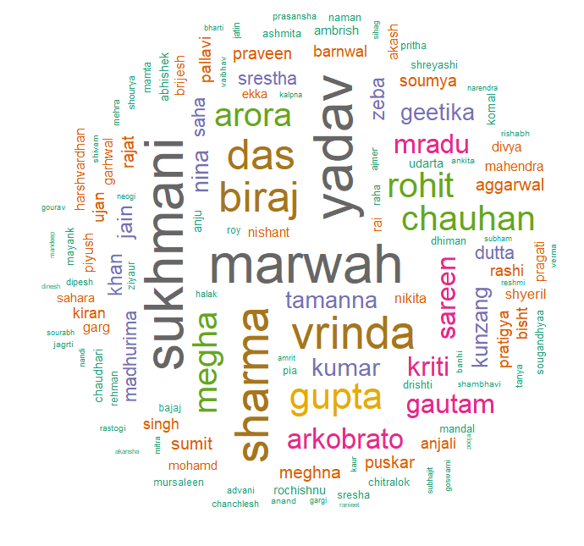
Word Cloud of Sender:
Frequency table for top 10 words in sender variable
word | freq
marwah | 753
sukhmani | 753
yadav | 751
sharma | 636
vrinda | 613
biraj | 566
das | 566
gupta | 481
chauhan | 439
rohit | 439
Here names and surname are considered as two different words.
Names are unique except two Pooja, and two Meghna etc.
But surnames are same in many cases like Gupta, Yadav and Singh and many more.

Slide 15
Sentimental Analysis

Slide 16
Sentiment analysis:
Sentiment analysis is extremely useful in social media monitoring as it allows us to gain an overview of the wider public opinion behind certain topic.
WhatsApp is most popular chat app with monthly active users of more than 700 million. The popularity of this app has made it a necessary app among smartphone users and even businesses and organizations use WhatsApp for daily communication in groups and across departments. Corporations get a huge amount of textual data from WhatsApp and they can leverage WhatsApp chat sentiment analysis to gain better insights about their employees and try to avoid unforeseen conflicts due to various redundancies and inefficiency of business processes.

Slide 17
About Sentiment Dictionary and Categories:
Here Use Function iterates over a vector of strings and returns sentiment values based on user supplied method. The default method, "syuzhet" is a custom sentiment dictionary developed in the Nebraska Literary Lab. The default dictionary should be better tuned to fiction as the terms were extracted from a collection of 165,000 human coded sentences taken from a small corpus of contemporary novels. At the time of this release, Syuzhet will only work with languages that use Latin character sets. This effectively means that "Arabic", "Bengali", "Chinese_simplified", "Chinese_traditional", "Greek", "Gujarati", "Hebrew", "Hindi", "Japanese", "Marathi", "Persian", "Russian", "Tamil", "Telugu", "Thai", "Ukranian", "Urdu", "Yiddish" are not supported even though these languages are part of the extended NRC dictionary.
The NRC Emotion Lexicon is a list of English words and their associations with eight basic emotions (anger, fear, anticipation, trust, surprise, sadness, joy, and disgust) and two sentiments (negative and positive).
A data frame where each row represents a sentence from the original file. The columns include one for each emotion type as well as a positive or negative valence. The ten columns are as follows: "anger", "anticipation", "disgust", "fear", "joy", "sadness", "surprise", "trust", "negative", "positive."

Slide 18
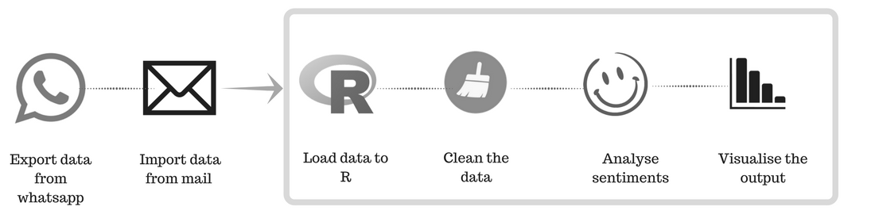
Process

Slide 19
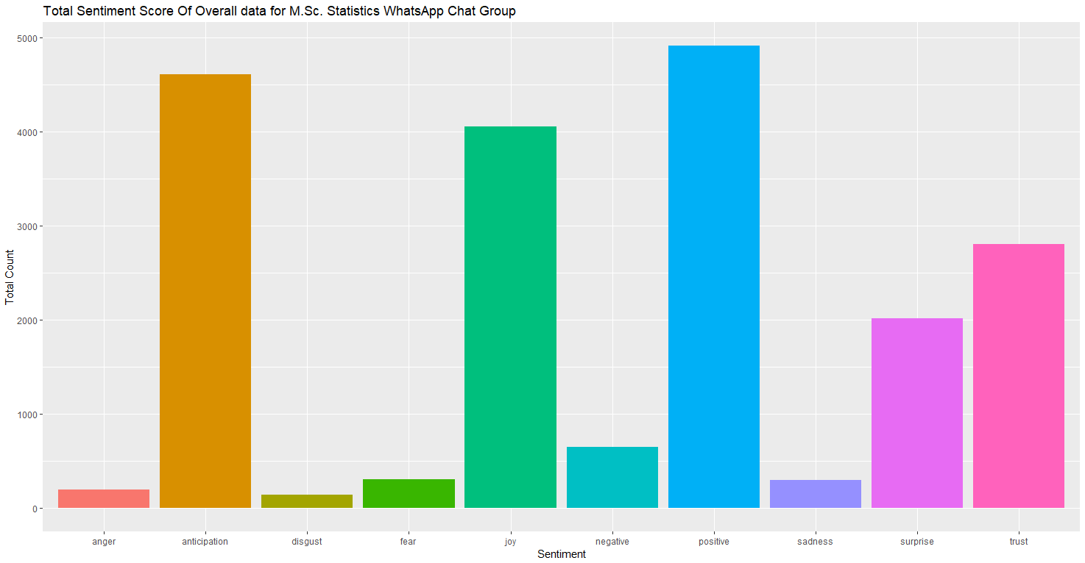
Sentiment Plot Of Group:

Slide 20
Thank You!!

